Slide 1
Bam vs WT RNA seq
Jonathan Snedeker

Slide 2
Transcription Regulates Cell Fate
Transcription
Translation
DNA
RNA
Protein

Slide 3
Transcription Regulates Cell Fate
Transcription
Translation
DNA
RNA
Protein
DNA remains the same in essentially all cells
Transcription varies widely between cell types such that the same DNA can produce different RNAs.

Slide 4
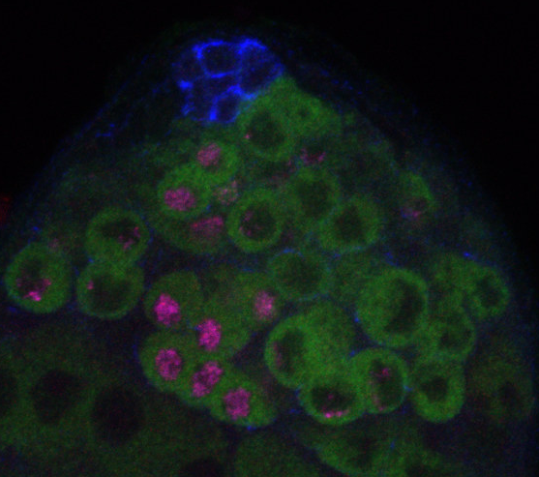
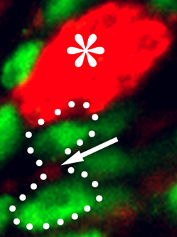
Asymmetrically Dividing Stem Cells Provide a Key Situation to Understand Cell Fate Decisions
Arm Edu CDC6 Endogenous
Fas3 Histone
Hub
*
GSC
GB
GSC
Spermatogonia
GB
Spermatocyte

Slide 5
Key Comparison: WT vs. Bam RNA-seq
RNA-seq is a technique that allows you to sequence the total pool of RNAs in cell types of interest.
Bam is a mutant that prevents germline differentiation. Therefore, Bam mutants have only undifferentiated stem cell like cells.
Comparing RNA-seq profiles of Bam and Wild type gives a basic understanding of what genes are preferentially expressed in stem cells (data from Gan Q, et al. Cell Research 2010).

Slide 6
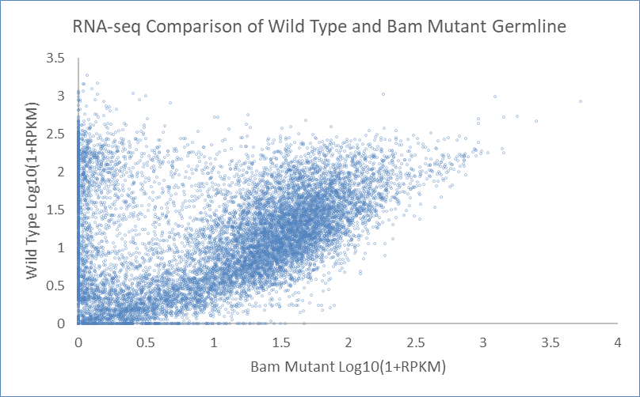
WT vs. Bam RNA-seq

Slide 7
WT vs. Bam RNA-seq

Slide 8
WT vs. Bam RNA-seq
Not Expressed in Germline

Slide 9
WT vs. Bam RNA-seq
Universally Expressed in Germline

Slide 10
WT vs. Bam RNA-seq
Stem Cell Enriched

Slide 11
WT vs. Bam RNA-seq
Differentiation Specific

Slide 12
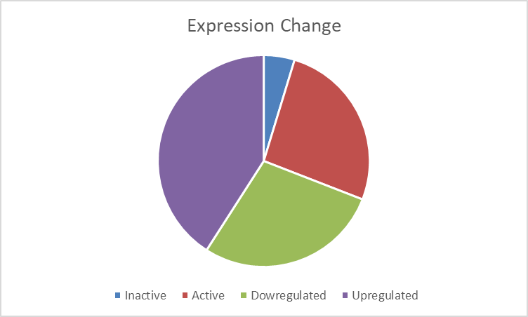
Categorizing Expression Change in the Germline

